Slide 1

Organic Agriculture Funding Opportunities
Dr. Mathieu Ngouajio
NIFA
Division: Plant systems-Production
Organic Conference Nov 13, 2014
Beltsville

Slide 2

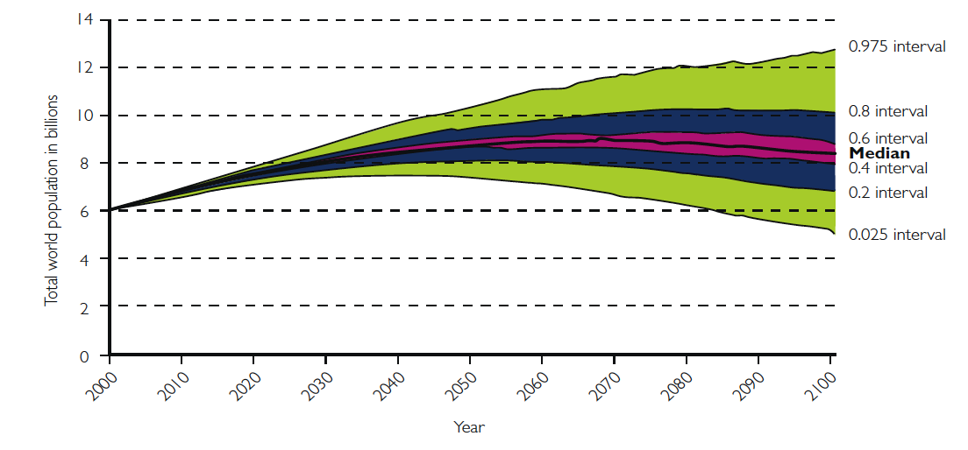
Meeting the challenges of a growing world population
Total world population in billions: probabilistic projections until 2100
Source: Foresight. The Future of Food and Farming (2011)

Slide 3

How to feed a growing world population
with minimum footprint on the environment?
Reduce global poverty and hunger
National security issue
Many initiatives currently underway
1st challenge !!!!
Ultimate challenge
We need new discoveries and technologies with global applications
Organic agriculture should be a key player in achieving these goals

Slide 4
Progress in agriculture
Since World War II there has been significant changes in agriculture due to news discoveries and leap frog technologies
Pesticides: herbicides, fungicides, insecticides, nematicides, soil fumigants, etc..
Fertilizers: specificity, placement, slow release…
Machinery: tractors, sprayers,
Technology: GPS, precision agriculture, plastics
Molecular biology: stress resistant cultivars
Fewer and fewer farms (2.1 million farms 2012) producing for the rest of the population (313.9 million 2012)

Slide 5
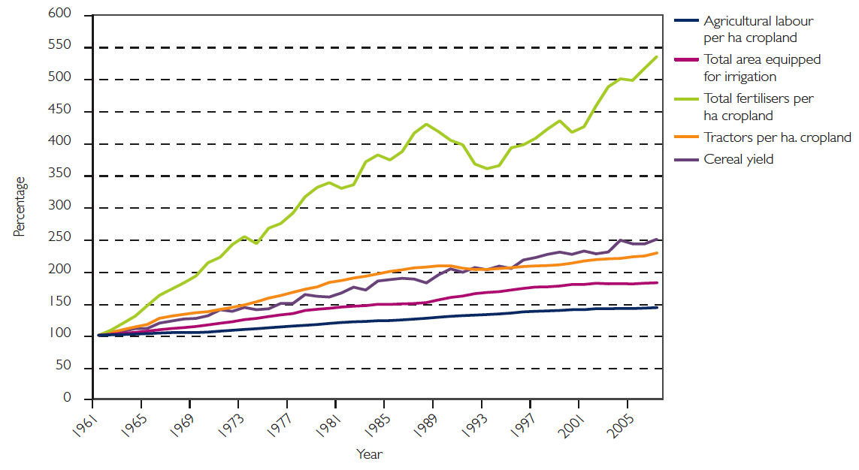
Global trends in the intensification of crop production
Source: Foresight. The Future of Food and Farming (2011)

Slide 6
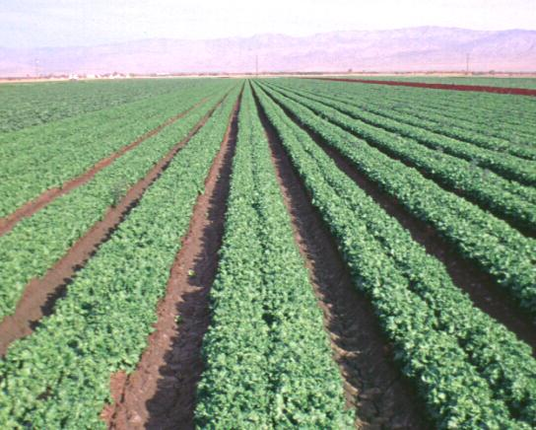
Monoculture systems
Lettuce field:
Coachella Valley California

Slide 7
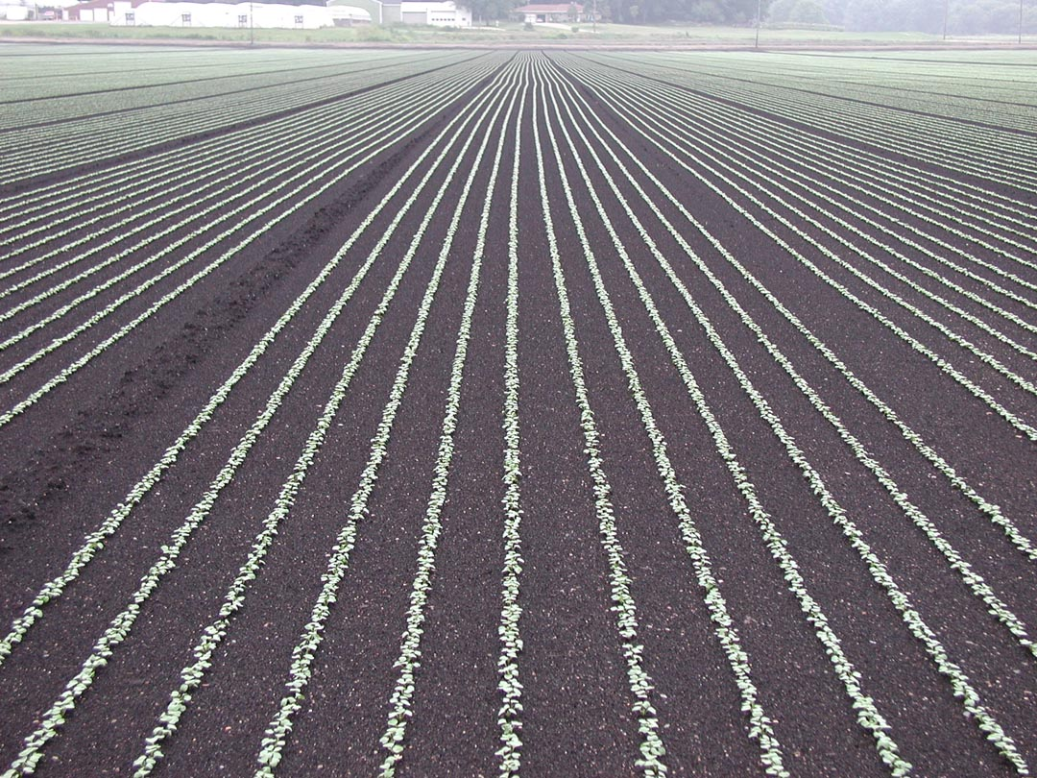
Radish: Michigan

Slide 8
Monoculture systems
Low level of biodiversity
High inputs
High pest and disease pressure
High potential for erosion
Appropriate for Large-scale production
Adapted to mechanization

Slide 9

1787 letter to Arthur Young in England
(227 yrs ago)
“Our lands, as I mentioned in my first letter to you, were originally very good; but use, and abuse, have made them quite otherwise.”
This was in reference to soil degradation caused by continuous tobacco or corn-wheat rotations in America

Slide 10
The organic agriculture approach
Increase crop diversification
Prohibit most synthetic inputs
Pesticides: herbicides, insecticides, fungicides, ….
Fertilizers
Hmmmm!
Without those tools I need to go back to the drawing board !!!

Slide 11
The need for a systems research
With few tools available the research needs to focus more on the entire cropping systems than specific practices.
Partnership between scientists and farmers becomes critical
Soil building becomes the foundation of the system
Critical need for a truly holistic approach in designing experiments
2nd challenge !!!!
How to put all the pieces together into a working and efficient system?

Slide 12
Components of an integrated cropping system
Soil quality
Plasticulture
Insects
Physiology
Genetics
Nematodes
Diseases
Weeds
Tillage
Economics
Hydroponics
Marketing
Engineering
Cover cropping
Fumigation
Irrigation
Allelopathy
Biodiversity
Integrated Cropping Systems
Systems approach to crop production

Slide 13
The need for a process-driven research
Studies based on observation will continue to play important role.
Critical to understand the processes underlying key observations
3rd challenge !!!!
This requires a solid scientific background

Slide 14
Process-driven research
More focus on underlying processes
How?
Why?
Input
Fertilizer
New variety
New practice
Etc..
Output
Yield
Pest control
Quality
Etc..
Without a good understanding of the processes it is difficult to replicate successful results

Slide 15

The need for appropriate student training
Few scientists have received formal training in organic ag.
It is critical to train the next generation of organic ag. scientists
Undergraduates
Graduates
5th challenge !!!!
Need to include organic courses in agricultural curricula
That will broaden student experiences
Capacity building

Slide 16
From general to specific priorities
Whole system research?
Soil Quality
Education
Extension
Specific priorities

Slide 17
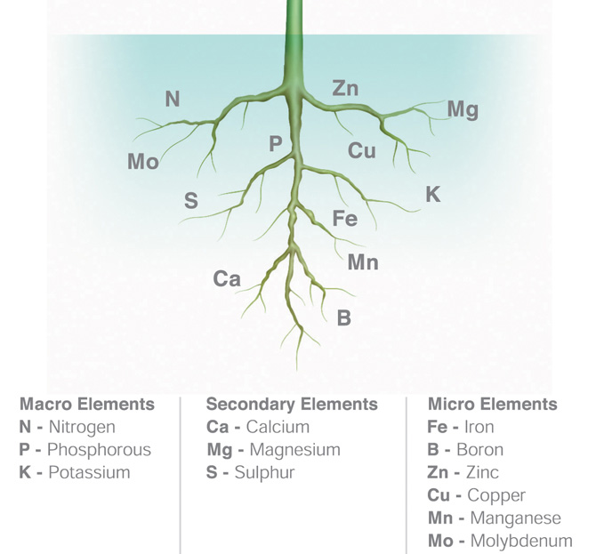
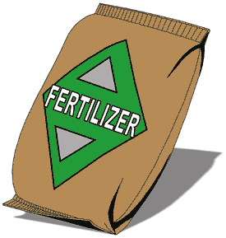
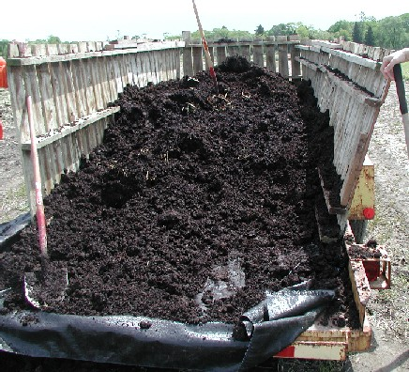
Nutrient management
Low external input systems
Improved nutrient cycling
Cultivars with improved nutrient use efficiency
Soil amendments
Cover cropping
Use of N fixing cover crops
Compost

Slide 18
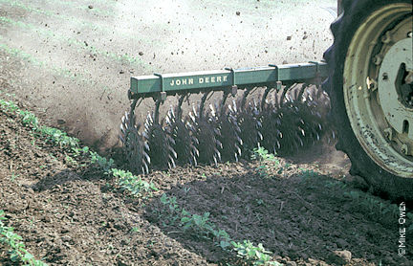
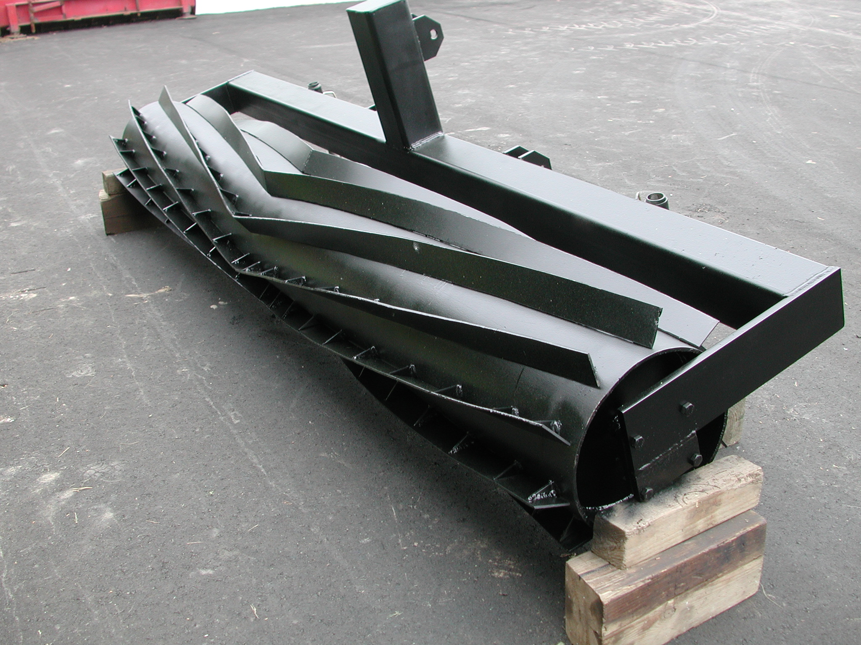
Weed management
Integrated management
Mechanical
Biological
Physical
Chemical
Cover cropping
No-till systems
Engineering
New tools
Roller Crimper

Slide 19
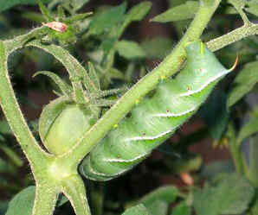
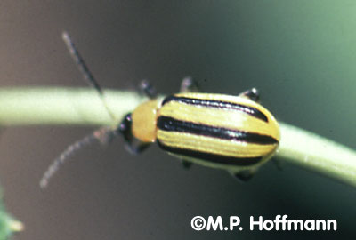
Insect management
Integrated management
Crop diversification
Trap cropping
Natural enemies
Biological insecticides
Etc.
Source: Colorado State Univ.
Source: Cornell Univ.

Slide 20
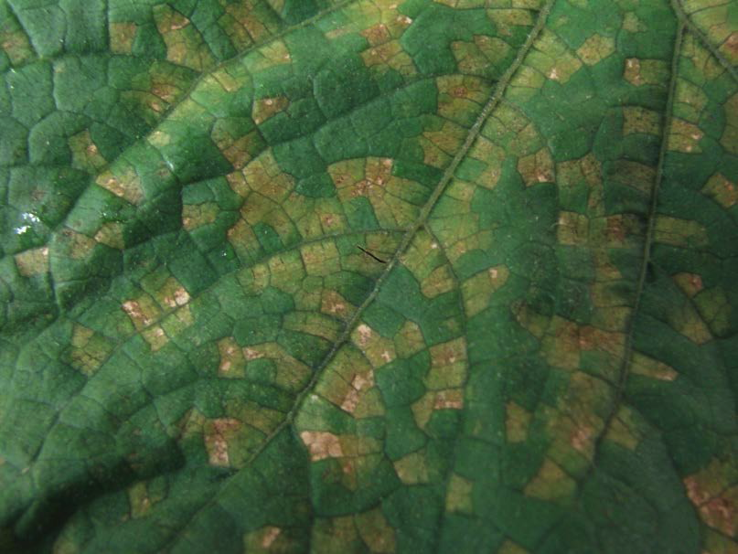
Disease management
Disease suppressive systems
Crop diversification
Soil quality
Resistant cultivars
Photo credit: Hausbeck Lab, MSU

Slide 21
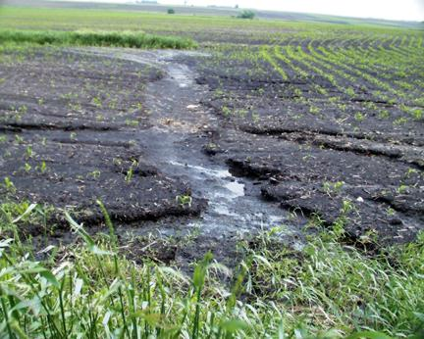
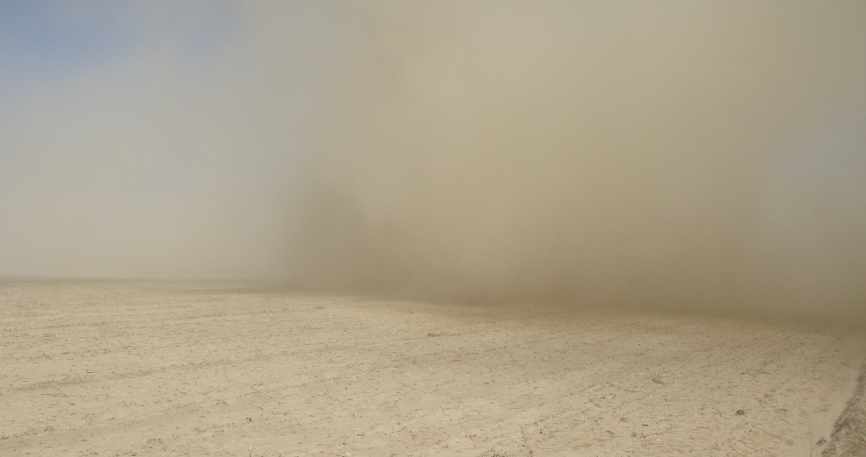
Ecosystem services
Impact of organic production on
Carbon sequestration
Greenhouse gas emission
Biodiversity
Soil conservation
Mahdi Al-Kaisi et al. 2002
www.weru.ksu.edu
Wind erosion

Slide 22


Funding opportunities in organic agriculture
Organic agriculture Research, Extension and Education can use extra funding
Where to go?
http://images.paraorkut.com/img/funnypics/images/s/sumo_wrestling_fight-13078.bmp

Slide 23
Funding of organic research
Focus on programs specific to organic agriculture

Slide 24
Organic Ag. Funding
Preliminary data from CRIS Database. Does not include data from other USDA agencies (ARS, AMS, etc.) and support from outside USDA

Slide 25

Ceres Trust Foundation
Organic Research Initiative (ORI)
Started in 2009
Universities in the 12-state North Central region.
About 10 grants of $60,000 max. each per year
Organic Research by Graduate Students
Started in 2010
North Central region.
About 10 grants of $10,000 max. each per year
35

Slide 26

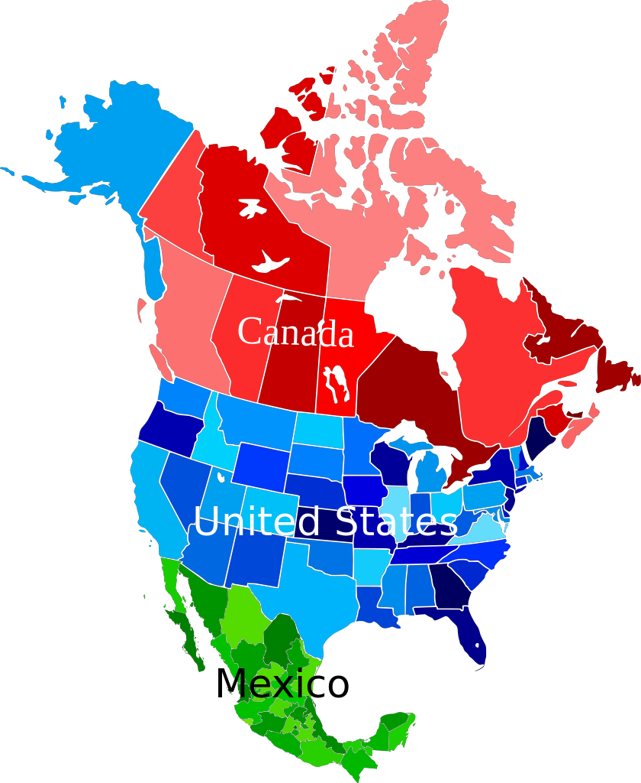
OFRF Grant program
Canada, Mexico, U.S.
Max. of $15,000/grant
Recent deadline was Thursday, May 15, 2014
Small grants but huge impact
Launching pad for larger projects
36

Slide 27
Organic Programs at NIFA
ORG
OREI
Organic Transitions
Organic Ag. Res. & Ext. Init.
Integrated Projects*
Research
Extension
Education
* Min. 2 functions
Others (historically)
Conference
Planning
Analytical
eXtension
$4 million available in 2014
About same amount in 2015
RFA Deadline: ?
Award Cap: $500,000
$20 million available in 2014
About same amount in 2015
RFA Deadline?
Award Cap: $50K to $2M

Slide 28
Funding to states by year
OREI Not Offered
?

Slide 29
ORG and OREI cumulative # of proposals by year
1,026 total
186
funded

Slide 30
ORG & OREI # of proposals submitted by state 2001-2014
60
50
WA
ME
40
MT
ND
MN
VT
NH
30
OR
NY
MA
20
ID
SD
WI
RI
WY
MI
CT
10
IA
PA
NJ
NE
OH
DE
0
NV
IN
WV
VA
MD
CA
UT
CO
KS
MO
IL
KY
DC
0
TN
NC
AZ
OK
AR
SC
NM
GA
MS
AL
*Continuations are counted as 1
TX
LA
FL
AK
HI
PR
GU

Slide 31
ORG & OREI # of proposals funded by state
2001-2014
24
20
WA
ME
16
MT
ND
MN
VT
NH
12
OR
MA
8
ID
SD
WI
NY
RI
WY
MI
CT
4
IA
PA
NJ
NE
IN
OH
DE
0
NV
IL
WV
MD
CA
UT
CO
KS
KY
VA
DC
>10
MO
NC
6-10
TN
1-5
OK
SC
0
AZ
NM
AR
GA
MS
AL
*Continuations are counted as 1
TX
LA
FL
AK
HI
PR
GU

Slide 32
2014 ORG-OREI Grant Distribution
WA
ME
3
MT
ND
MN
VT
NH
OR
3
3
WI
NY
MA
ID
SD
MI
RI
WY
PA
CT
2
NJ
NE
IA
OH
DE
NV
IL
IN
WV
CA
UT
VA
MD
CO
KS
MO
KY
TN
NC
AZ
OK
AR
SC
NM
GA
MS
AL
2
TX
LA
FL
AK
HI
PR
GU

Slide 33

Some keys to success for NIFA Organic Programs
Human Capacity
Critical mass of organic scientists working together
Strong connection University-Extension-Organic industry
Institutional capacity
Support from the upper administration
Certified facility for research

Slide 34
Thank you !!!!!!

